Slide 1
Title: Mobile Based Ethio-Encarta Application
Name ID
Amlaku Beyene…………2051/07
Ananke Yilak…………..…2139/07
Ylikal Ayalaw……..…..….1973/07
Balemlay Tilahun…...........1982/07
Tizta Endresaw..………....1984/07
Information system section one
Group six(6)

Slide 2
Introduction
Ethiopia is a country located in the Horn of Africa.
Ethiopia, the oldest independent nation in Africa, has a heritage dating back to first century AD
Some of the oldest skeletal evidence for anatomically
modern humans has been found in Ethiopia
It is widely considered as the region from modern humans

Slide 3
Cont.…
Ethiopia has its own culture, nation nationality, tradition,
calendar, custom, metabolism and type’s cultural game
the context of our country there is absence of technology
which supports both literate and illiterate users on the case of information broadcasting in the form of encyclopedia or multimedia system
the objective of the proposed system is
developing information delivery system about Ethiopia

Slide 4
Objectives
General objectives
The general objective of this project is to design and implement mobile based Ethio-Encarta system.
specific objective
To acquire the necessary information and knowledge from different sources by using appropriate methodology.
To elicit information to understand the problem of the existing system in order to propose a better and a working solution.

Slide 5
Scope and limitation
Scope
The scope of this project is to develop mobile based Ethio-Encarta system in local language and foreigner language.
It includes:-Historical place ,Famous people,
Cultural Games in Ethiopia religions, History
of Ethiopian music, dance style, Environment ,agriculture

Slide 6
Cont.…
Limitation of the project
The scope of the project work is limited to the following:
The proposed system only support android based mobile.
The proposed system not support online Amharic information

Slide 7
Significant of the project
It reduces cost or save money.
Users will access the needed information easily
for different use.
Researcher to collect information easily for research and other purposes.
For students those have an interest to study about their country.
It saves too much of time consumption by easily access information by his/her mobile phone or smart phone.
.

Slide 8
Con….
Users know what Ethiopia has in different direction like today and past.
Used for truism office for the tourist see this application
and access information about Ethiopia and need to
see this truism

Slide 9
Methodology
Data collection method
The requirement of the system is gathered using primary and secondary data collecting techniques. These are listed below.
Observation
Encyclopedia
Document analysis

Slide 10
Introduction to the existing system
The current Ethio-Encarta system is implemented on foreigner’s language English
And the current Ethio-Encarta system is focus on the information in historical place, famous people, transport system, bank, hotel, region and realign.
But the application not broadcast the information based on its contents and the information is not good to accesses and

Slide 11
Con….
makes confusion and the existing mobile based Ethio-Encarta application is not broadcast full information about Ethiopia.
The existing system not implemented with Amharic language.

Slide 12
Players in the existing system
Players represent external entities that interact with the system.
Here are the players involved:
All Peoples (The peoples that read English language): people who are getting information from the system.

Slide 13
Business rules
The business rule is a principle or a policy in which the proposed system operates accordingly.
The main business rules or principles of the existing system are: -
BR1- Before using Encarta application, peoples must install the application to their device.

Slide 14
Requirements of the proposed system
Functional requirements
are concerned about the major activities that the system has to be performed. Some of them are:
The system enables the user to view information
The system enables the user to search the
intended information.
View information
Search information

Slide 15
Con….
Manage information
Upload information
Delete information
Manage user account

Slide 16
Non-functional requirements
Availability: This system should always be available for access at 24 hours; 7 days a week
Security: Administer and information recorder is authenticated before managing the information or manage information
Performance and Response time: - The system should have high performance rate

Slide 17
Cont.…
Usability: As the system support Amharic language the illiterate user who can’t read and
Understand English language can easily understand the proposed system

Slide 18
Use case model

Slide 19
Analysis Level Class Diagram

Slide 20
Sequence Diagram for login

Slide 21
Activity Diagram for login

Slide 22
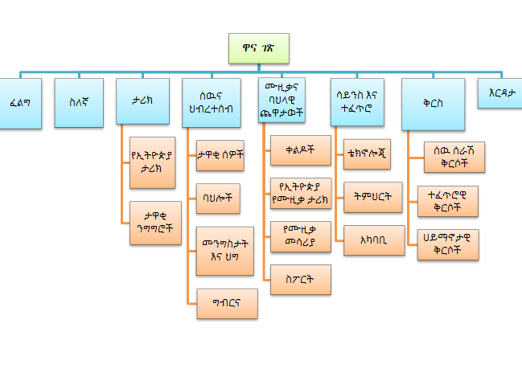
User Interface prototype for Amharic mobile

Slide 23
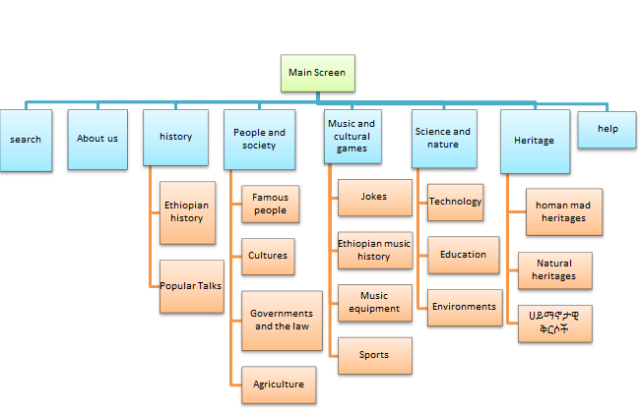
User Interface prototype for English mobile

Slide 24
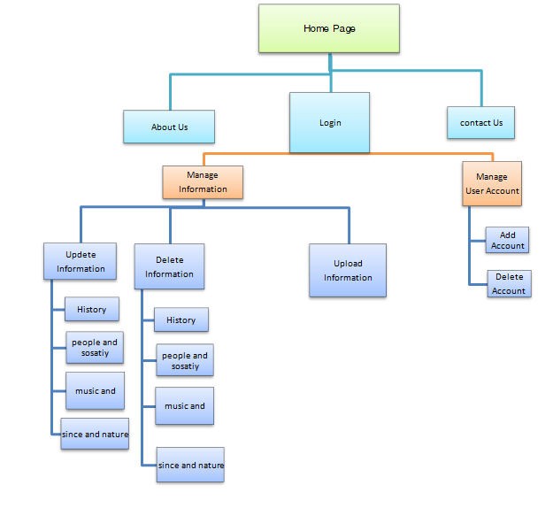
User Interface Prototype for Administer page

Slide 25
Design Goals
Design goals are derived from the nonfunctional requirement of the system
Security: The system should provide a better level of security and integrity of the data
Performance and Response time: The system should have high performance rate
when executing user’s input and should be able to provide feedback or response within a short time span.

Slide 26
Cont.…
Availability: This system should always be available for access at 24 hours, 7 days a user’s can simply access the application.

Slide 27
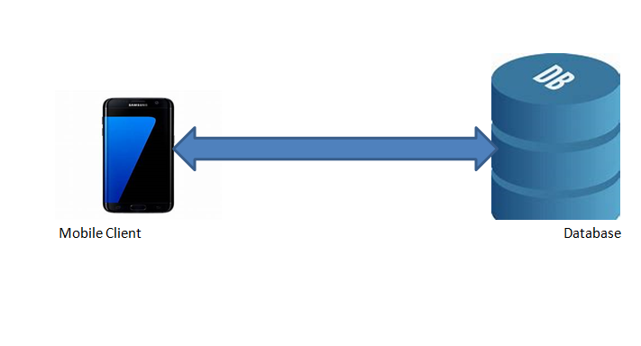
Current System Architecture

Slide 28
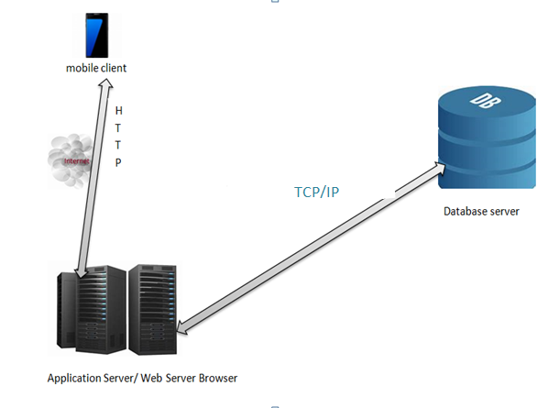
Proposed System Architecture

Slide 29
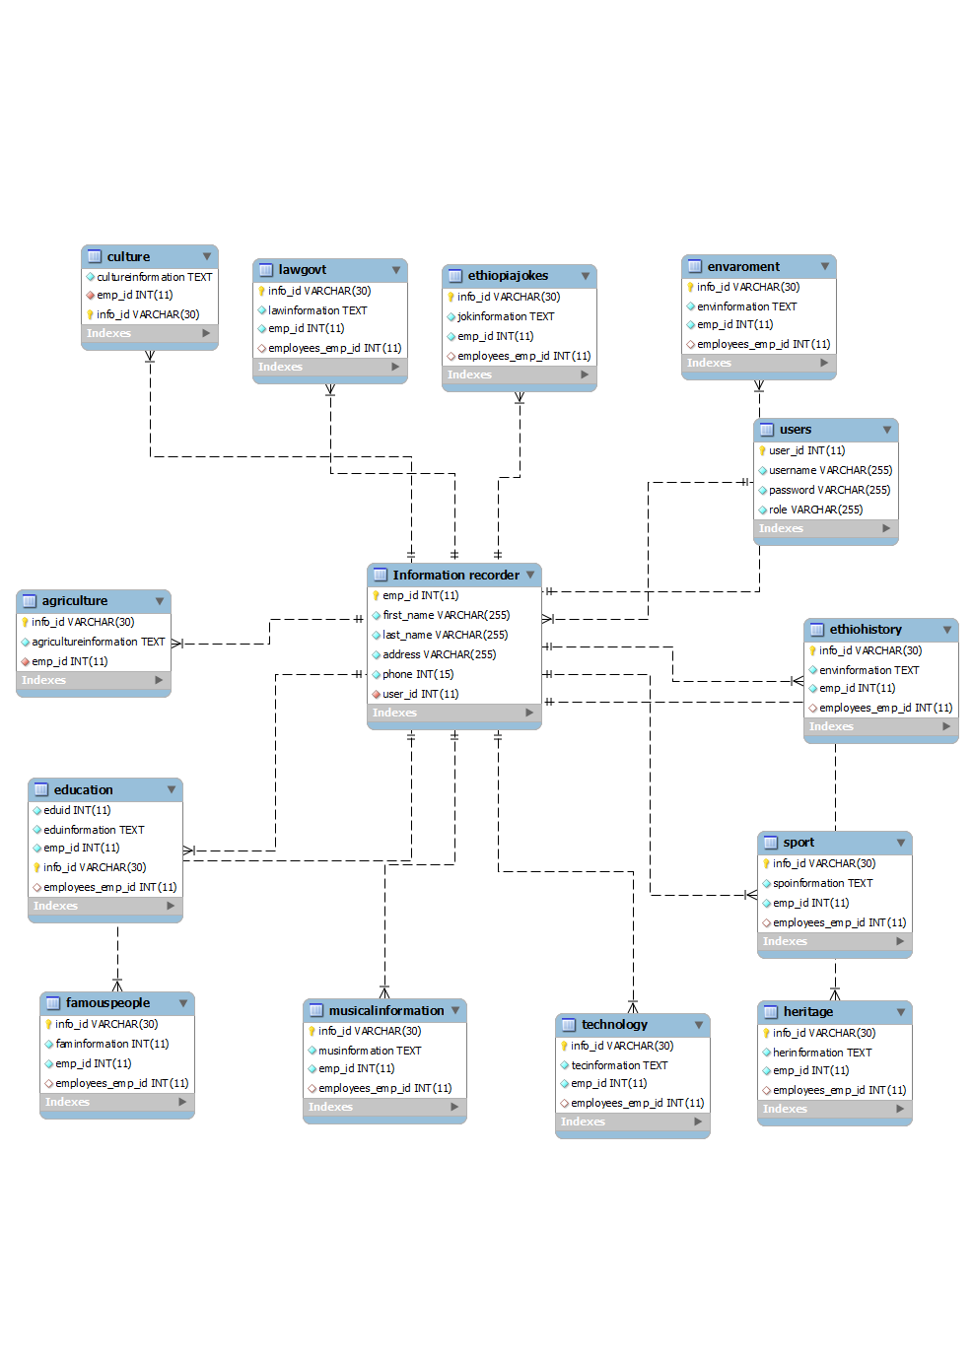
Database Design

Slide 30
Deployment Diagram

Slide 31
Conclusion
We development this project with two phases; the first phase deals with the analysis phase of the development life cycle, and the next phase addresses design, implementation and testing issues.

Slide 32
Recommendation
Multi region supporters: our system only deployed on Amharic and English
but the Amharic information is offline there is no online information for Amharic users then
we recommend that the next developer will consider all regions of Ethiopia language and make them online

Slide 33
Con..
And recommend the next developer to develop in Encarta with different language like oromifa,tigrgn,and other Ethiopian language with sound support.

Slide 34
Thankyou
Thankyou

